Slide 1

DRL
Final Project Group 1
Presenter: Liao Wei Syuan
11 June, 2024

Slide 2
Content
1
4
Introduction
Experiments
2
5
Related Work
Conclusion and Future Work
3
Methodology

Slide 3
Content
1
4
Introduction
Experiments
2
5
Related Work
Conclusion and Future Work
3
Methodology

Slide 4

Introduction
Goal:
Use DRL methods to train an agent to play MsPacman-v5
Challenge:
MsPacman-v5 presents a complex environment with various game states and interactions, handling this complexity and ensuring that the agent learns effectively in such an environment can be difficult

Slide 5
Content
1
4
Introduction
Experiments
2
5
Related Work
Conclusion and Future Work
3
Methodology

Slide 6
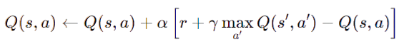
Related Work
Q-learning
A value-based, model-free reinforcement learning algorithm that aims to learn the value of state-action pairs
Q-values represent the expected future rewards of taking a certain action in a given state
Update rule:

Slide 7
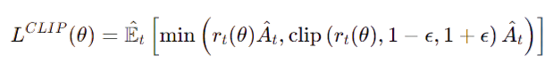
Related Work
Proximal Policy Optimization (PPO)
A policy-based, model-free reinforcement learning algorithm that optimizes the policy directly
Instead of learning value functions, PPO directly optimizes the policy that the agent uses to decide actions
Update rule:

Slide 8
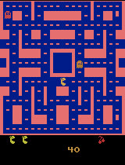
Related Work
MsPacman-v5 Environment
Action Space | Discrete(9)
Observation Space | Box(0, 255, (210, 160, 3), uint8)
Reward | Score

Slide 9
Content
1
4
Introduction
Experiments
2
5
Related Work
Conclusion and Future Work
3
Methodology

Slide 10
Methodology
Q-learning Agent - Environment:
Initialization: Uses deque to store last 4 frames
Reset Method: Resets the environment, initializes frame deque with preprocessed frames
Step Method: Takes action, receives next frame, reward, and done status, preprocesses frame, updates frame deque
Preprocessing Frames: Converts frames to grayscale and resizes to 64x64 pixels
Observation Method: Returns stack of last 4 preprocessed frames

Slide 11
Methodology
Q-learning Agent - Training Details:
Q-learning Setup
State Size: 1,000,000 (hash size for large state space)
Action Size: 9
Q-table: Initialized with zeros, dimensions (state_size, action_size)
Device: GPU(google colab: T4) if available, otherwise CPU

Slide 12
Methodology
Q-learning Agent - Training Details:
Training Parameters
Total Episodes: 500,000 (stop at 8,000)
Max Steps per Episode: 200
Learning Rate: 0.01
Discount Factor (gamma): 0.99
Epsilon (ε): Initial 1.0, max 1.0, min 0.001, decay rate 0.01

Slide 13
Methodology
PPO Agent - Environment:
Initialization: Uses deque to store last 4 frames, initializes observation space and action space
Reset Method: Resets the environment, initializes frame deque with the initial observation
Step Method: Takes action, receives next frame, reward, and done status, updates frame deque
Observation Method: Returns stack of last 4 frames concatenated along the channel axis

Slide 14
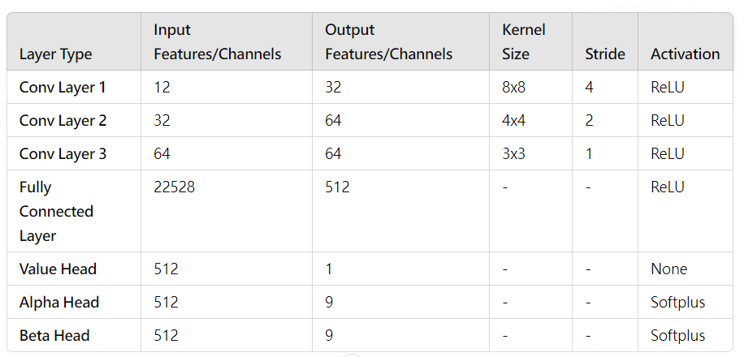
Methodology
PPO Agent - Network

Slide 15
Methodology
PPO Agent - Training Details:
Hyperparameters:
Learning Rate: 0.001
Discount Factor (γ): 0.99
Image Stack: 4 images
PPO-Specific Parameters:
Clip Parameter: 0.1
PPO Epoch: 10
Buffer Capacity: 2000 transitions
Batch Size: 128

Slide 16
Content
1
4
Introduction
Experiments
2
5
Related Work
Conclusion and Future Work
3
Methodology

Slide 17
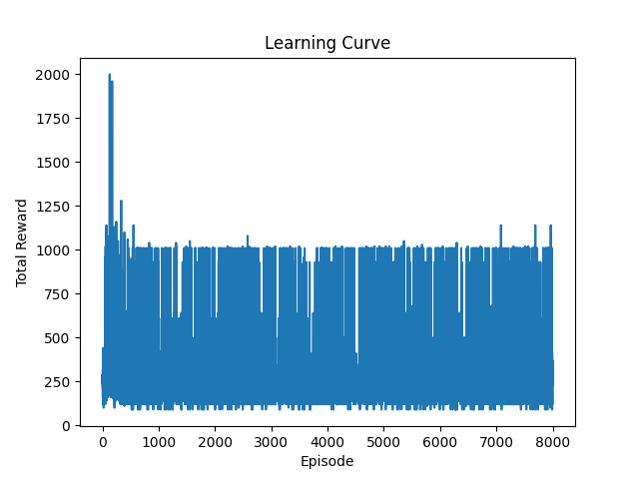
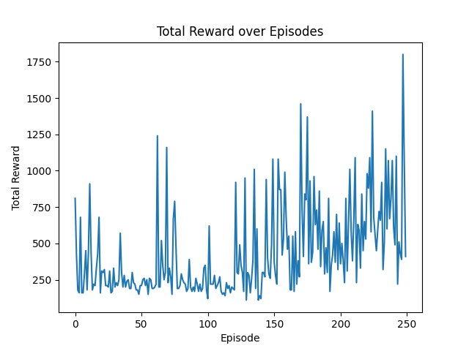
Experiments
Learning Curve:
Q-learning
PPO

Slide 18
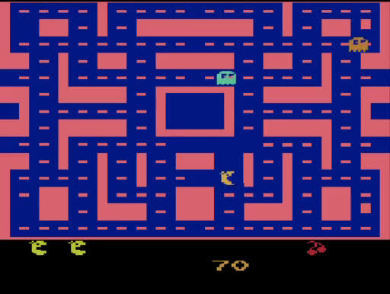
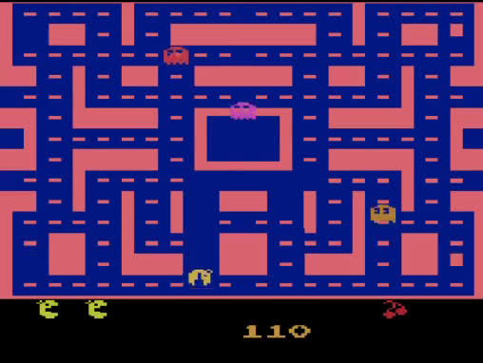
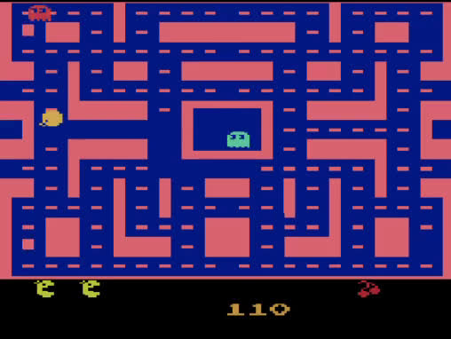
Experiments
Demo
Random
Q-learning
PPO

Slide 19
Experiments
Average Rewards for 10 rounds:
Agent | Rewards
Random | 221
Q-learning | 326
PPO | 967

Slide 20
Content
1
4
Introduction
Experiments
2
5
Related Work
Conclusion and Future Work
3
Methodology

Slide 21
Conclusion and Future Work
PPO agent successfully learned to play MsPacman, surpassing baseline performance
Q-learning agent struggled with the high-dimensional state space and complex game dynamics
Explore advanced techniques like Deep Q-Networks (DQN) to handle complex environments
Experiment with different architectures and hyperparameters to further optimize performance

Slide 22
Thank you

